Slide 1

FY 2018 Vehicle Analysis

Slide 2
Goal & Method
Goal: The goal of this model is to better understand how to make better car purchase decisions by considering FY 2018 cost and revenue data.
Method: Use FY 2018 cost and revenue data to project into FY 2019, at both vehicle and company level. To do this we will look at specific key insights regarding:
Areas of Strength (High-Earning Vehicles).
Areas of Weakness (Unprofitable Vehicles).
Areas of Interest (General Ideas for Improvement).

Slide 3
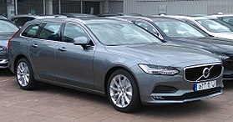

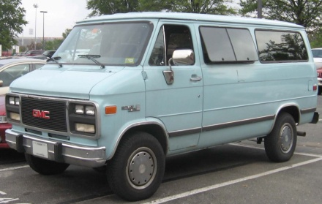
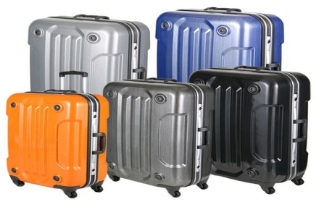
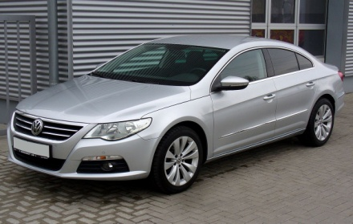

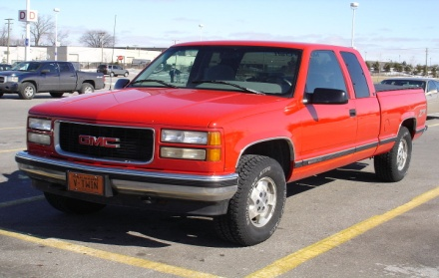

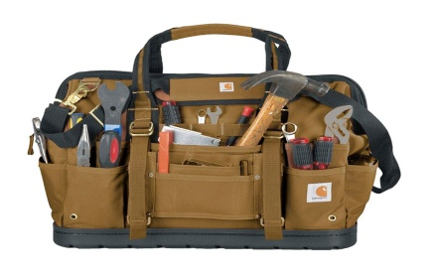
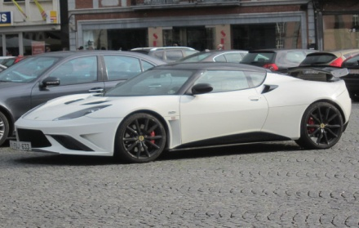
Key Insight 1: Areas of Strength
With 10,000 rental transactions in FY 2018, we achieved an overall net profit of almost $32 million.
Out of our 4,000 vehicle fleet, 3,945 vehicles operated at a net profit, or 98.6%.
Each of our top 5 average most profitable make and model of vehicle reported no accidents and represent their own specific class/archetype:
Volvo V90 (a safety oriented family station wagon).
GMC Rally Wagon G3500 (a spacious cargo van).
Volkswagen CC (a standard 4 door sedan).
Chevrolet G-series 3500 (a work oriented pick-up truck).
Lotus Evora (a high-performance sports car).
#1
#2
#3
#4
#5

Slide 4
Key Insights of Strength: Data
Top 5 Net Revenue by Make & Model
Make and Model | Average Annual Net Revenue | Sum of Accident Incidents
Volvo V90 | $18,793.88 | 0
GMC Rally Wagon G3500 | $18,658.68 | 0
Volkswagen CC | $18,162.12 | 0
Chevrolet G-Series 3500 | $17,407.72 | 0
Lotus Evora | $16,644.28 | 0

Slide 5
Key Insights of Strength: Recommendations
Based on my findings from areas of strength, I would recommend looking to purchase 20 of each of the top performing vehicles in our fleet, according to average net revenue, because they are the best at filling a specific need for the driver (best in class).
The Additional 100 vehicles project to increase:
Gross Revenue by ~$2.7 million or 4%, up to 67.4 million.
Net Revenue by ~$1.9 million or 6%, up to $33.5 million.
Impact of Recommended Purchases on Revenue
Vehicle Make & Model | Average Gross Revenue per Vehicle FY 2018 | Additional Vehicles Purchased | Impact on Gross Revenue | Impact on Net Revenue
Volvo V90 | $ 26,816.00 | 20 | $ 563,136.00 | $ 394,671.48
GMC Rally Wagon G3500 | $ 26,013.00 | 20 | $ 546,273.00 | $ 391,832.28
Volkswagen CC | $ 26,739.00 | 20 | $ 561,519.00 | $ 381,404.52
Chevrolet G-Series 3500 | $ 24,814.00 | 20 | $ 521,094.00 | $ 365,562.12
Lotus Evora | $ 24,187.00 | 20 | $ 507,927.00 | $ 349,529.88
Total | $ 128,569.00 | 100 | $ 2,699,949.00 | $ 1,883,000.28

Slide 6
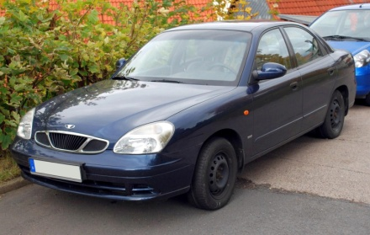

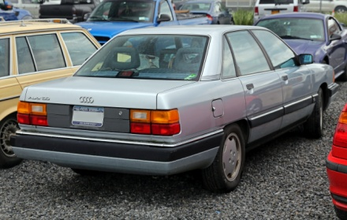
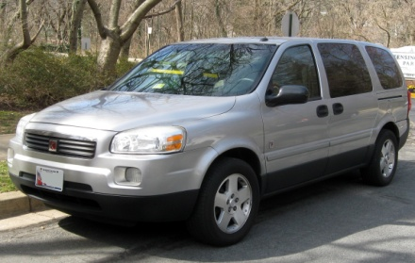
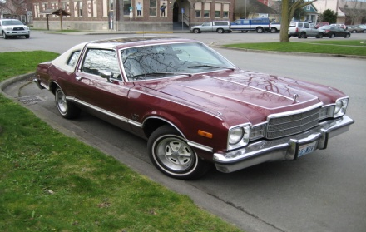
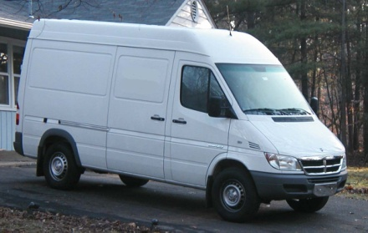

Key Insight 2: Areas of Weakness
Given our extensive vehicle fleet, we maintained an overall cost of around $33 million in FY 2018.
Out of our 4,000 vehicle fleet, 55 vehicles operated at a net loss, or 1.4%.
Our bottom 5 average least profitable make and model of vehicles, reported two accidents and 4 of the 5 operated at a net loss:
Daewoo Nubira (Operated at Net Loss).
Audi 5000CS (Operated at Net Loss).
Saturn Relay (Operated at Net Loss).
Plymouth Volare (Operated at Net Loss).
Dodge Sprinter (Operated at Net Gain).
#1
#2
#3
#4
#5

Slide 7
Key Insights of Weakness: Data
Bottom 5 Net Revenue by Make & Model
Make and Model | Average Annual Net Revenue | Sum of Accident Incidents
Daewoo Nubira | ($2,497.92) | 1
Audi 5000CS | ($1,681.80) | 0
Saturn Relay | ($1,296.76) | 0
Plymouth Volare | ($160.32) | 0
Dodge Sprinter | $794.16 | 1

Slide 8
Key Insights of Weakness: Recommendations
Based on my findings from areas of weakness, I would recommend shedding the bottom 5 performing vehicles from our fleet.
I would also recommend looking to purchase:
Vehicles that are not prone to accidents, as 2 of the bottom 5 cars have had incidents, and
Vehicles of a more widely known make and model;
Vehicles like the Daewoo Nubira, Saturn Relay and Plymouth Volare have not achieved great commercial success.
If we were to shed just the bottom 5 unprofitable and unpopular vehicles from our lineup, we would save ~$5,000 in net losses.
Impact of Recommendation on Revenue
Vehicle Make & Model | Count of Vehicle in Fleet | Total Car Annual Cost | Annual Net Revenue | Accident Incidents
Daewoo Nubira | 1 | $10,027.92 | ($2,497.92) | 1
Audi 5000CS | 1 | $10,012.80 | ($1,681.80) | 0
Saturn Relay | 1 | $9,677.76 | ($1,296.76) | 0
Plymouth Volare | 1 | $8,728.32 | ($160.32) | 0
Dodge Sprinter | 1 | $7,293.84 | $794.16 | 1
Total | 5 | $45,740.64 | ($4,842.64) | 2

Slide 9
Key Insight 3: Areas of Interest
The 2018 vehicle average summary findings show that profitable vehicles average about twice as much gross revenue while costing about $1,000 less per year when compared to unprofitable vehicles.

Slide 10
Key Insights of Interest: Data
Breaking this down further by cost, it seems that the average price of insurance for unprofitable vehicles is about $110 per month, 10$ more than the profitable vehicles, on average.

Slide 11
Key Insights of Interest: Recommendations
Based on my findings from areas of interest, I would recommend looking to purchase vehicles and insure vehicles below:
The average annual cost of Unprofitable Vehicles in FY 2018: ~$9,300.
The average monthly insurance costs for Unprofitable Vehicles in FY 2018: ~$110.
Also, if we were to shed the 55 unprofitable vehicles that contributed to this metric, it would result in a cost savings of over $500,000 a year and result in a shedding of $58,000 in net losses.
Impact of Recommendation on Revenue
 | Count of Unprofitable Vehicles | Average Monthly Car Insurance Cost | Average Annual Total Car Cost | Sum of Total Vehicles Annual Cost | Total Net Losses | Average Net Loss by Vehicle
Grand Total | 55 | $109.86 | $9,347.19 | $514,095.72 | ($58,090.72) | ($1,056.19)

Slide 12
Conclusion & Recommendations
In conclusion, with the findings from areas of strength, areas of weakness & areas of interest I would recommend:
Purchasing 20 of each of the top 5 performing cars in our fleet (those that were best at filling a specific need for the driver) as the data indicates this would lead to:
A Total Gross Revenue increase of over $2.7 million to $67.4 million (a 4% increase over the previous year).
A Net Revenue increase of ~$1.9 million to a total of $33.5 million (a 6% increase over the previous year).
Shedding the bottom 5 unprofitable and unpopular vehicles from our lineup as we would save ~$5,000 in net losses.
Selling our own unprofitable vehicles, and avoiding the purchase of other vehicles, whose average annual cost totaled over $9,300 and average monthly insurance costs totaled over $110.
Jettisoning the 55 vehicles in our fleet that contributed to this metric, would result in a cost savings of over $500,000 a year and result in a shedding of $58,000 in net losses.

Slide 13
Recommendation Data Projections
Following these recommendations, and factoring in increased costs, I project an increase in Gross Revenue of 4% up to $67 million and more interestingly an increase in net revenue of 6% up to $33.6 million.

Slide 14
Questions?

